Slide 1
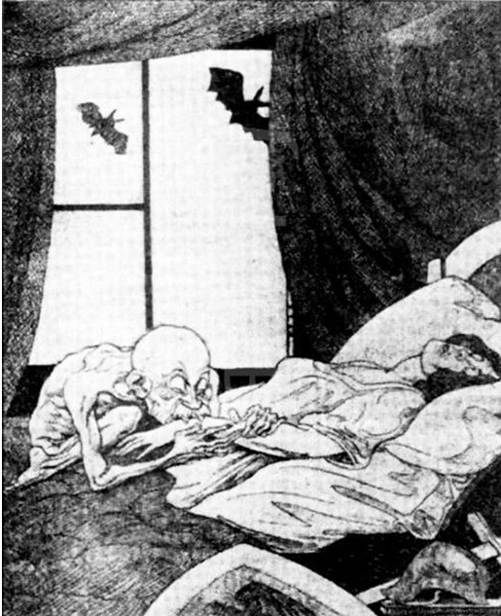

Source B - A cartoon entitled ‘Clemenceau the Vampire’. From the German right-wing satirical magazine Kladdertatsch, July 1919.
Source C – From a German newspaper, Deutsche Zeitung, 28 June 1919
Vengeance! German nation! Today in the Hall of Mirrors [Versailles] the disgraceful treaty is being signed. Do not forget it. The German people will, with unceasing work, press forward to reconquer the place among nations which it is entitled. Then will come vengeance for the shame of 1919.
Tasks:
1.Read the Source B paragraph
2. Using 3 different highlights, identify the following:
Where I identify what the source says about the Q
Where I use my own knowledge to explain why this is useful
Where I explain how the PROVENANCE effects its usefulness
Q3 (a) – How useful are sources B and C for an enquiry into attitudes in Germany towards the Treaty of Versailles? Explain your answer using Sources B and C and your knowledge of the historical context. (8 marks)
Source B is useful for learning about attitudes in Germany towards the Treaty of Versailles because it shows people felt negatively about it. It shows this by having the women who represents Germany having the life sucked out of her by an evil vampire who represents the leader of France who was responsible for the Treaty. This is useful because it is true. People in Germany did not like the Treaty of Versailles because they thought it was harsh to Germany. They didn’t like the fact Germany had to accept full responsibility for WW1 when they were not the only cause of it. They felt the 6.6 billion reparations they had to pay would destroy the German economy and ‘suck the life’ out of them. The provenance makes it useful because it is a German magazine so should represent German views. However, the fact it is a political cartoon in a right wing magazine might mean it exaggerates the bad feelings because satirical cartoons are not designed to give 100% accurate information but to get peoples attention about an issue. The right-wing groups in Germany hated the Treaty the most so this may not be representative of all peoples views in Germany
Source C is useful for learning about attitudes in Germany towards the Treaty because it shows..
This is useful because I know that…
The provenance makes it useful because…

Slide 2
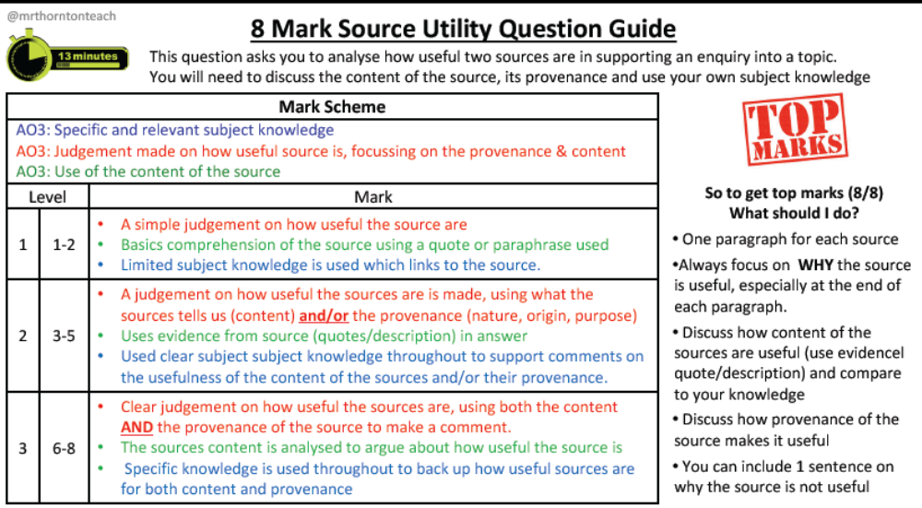

Slide 3
Source B – From the papers of Jan Smuts, a South African politician who visited Germany in 1918.
Motherland of our civilisations [Germany] lies in ruins, exhausted by the most terrible struggle in history, with its peoples broke, starving, despairing, from sheer nervous exhaustion, mechanically struggling forward along the paths of anarchy [disorder with no strong authority] and war.
Source C – From an article in a government newspaper, 1919.
The despicable actions of Liebknecht and Rosa Luxemburg soil the revolution and endanger all its achievements. The masses must not sit quiet for one minute longer while these brutal beasts and their followers paralyse the activities of the republican government and incite the people more and more to civil war.
Tasks:
1.Read the Source B paragraph
2. Using 3 different highlights, identify the following:
Where I identify what the source says about the Q
Where I use my own knowledge to explain why this is useful
Where I explain how the PROVENANCE effects its usefulness
Q3 (a) – How useful are Sources B and C for an enquiry the problems the Weimar Government faced after WW1 ? Explain your answer, using Sources B and C and your knowledge of the historical context.(8marks)
Source B is useful for learning about the problems the Weimar government faced because it shows that WW1 had left Germany ‘exhausted… starving’ and the mention on anarchy suggests they found it difficult to rule and not everyone respected them. This is useful as this reflects the problems they faced. The Germany economy was in ruins after WW1 and there were food shortages due to the naval blockade so people would have been starving. The new government couldn’t fix this overnight. There was also a sense of anarchy as there were rebellions and uprisings like the Spartacist Revolt and the Kapp Putsch. The provenance of the source makes it useful because it is from someone who visited Germany at this time and as a South African politician he has no reason to lie about what he saw. However, he only visited in 1918 which was probably the hardest year For Germany as the war had just ended. This makes it limited as the Weimar government did get stronger over time.
Source C is useful for learning about the problems the Weimar Government faced because it shows..
This is useful because I know that…
The provenance makes it useful because…

Slide 5
Source B – From a German journalist, written in 1928
In comparison with what we expected after Versailles, Germany has raised herself up to shoulder the terrific burden of this peace in a way we would never have thought possible. So that today after ten years we may say with certainty ‘Even so, it might have been worse’. The stage of convalescence from Versailles is a very long road to go and we have travelled it surprisingly quickly.
Source C – From a speech by Stresemann, 1929
The economic position is only flourishing on the surface. Germany is in fact dancing on a volcano. If the short-term loans are called in by America, a large section of our economy would collapse.
Tasks:
1.Read the Source B paragraph
2. Using 3 different highlights, identify the following:
Where I identify what the source says about the Q
Where I use my own knowledge to explain why this is useful
Where I explain how the PROVENANCE effects its usefulness
Q3 (a) – How useful are Sources B and C for an enquiry into German recovery in the years 1924-29? Explain your answer, using Sources A and B and your knowledge of the historical context. (8 marks)
Source B is useful for learning about the German recovery in the years 1924-29 because it shows that they did recover. It shows this when it says ‘Germany has raised herself up to shoulder the terrific burden’. This is useful as between 1924-29 Gustav Stresemann introduced changes which did help Germany recover. For example he ended hyperinflation by introducing a new German currency called the Retenmark which was much more stable. This meant that money was worth something once again. He also negotiated loans with America through the Dawes and Young Plan which helped Germany pay the reparations expected of them at the Treaty of Versailles. This allowed Germany’s economy to recover quicker than it would have done. The provenance of the source makes it less useful however as it is from a German journalist who may be more likely to be pro-Germany and to exaggerate the recovery. The date makes it limited too as it is from 1928 which is before the German recovery collapsed in 1929 after the Wall Street Crash. This means it doesn’t give the full picture.
Source C is useful for learning about the German recovery between 1924-29 because it shows..
This is useful because I know that…
The provenance makes it useful because…

Slide 7
Source B – The pledge of loyalty and obedience taken by members of the SA As a member of the NSDAP, I pledge myself by its storm flag to: Be always ready to stake life and limb in the struggle for the aims of the movement Give absolute military obedience to my military superiors and leaders Bear myself honourably in and out of service | Source C – A member of the Nazi Party describing one of Hitler’s speeches in 1922. My critical faculty was swept away. Leaning forward as if he were trying to force his inner self into the consciousness of all these thousands, he was holding the masses, and me with them, under a hypnotic spell by the sheer force of his belief … I forgot everything but the man; then glancing around, I saw that his magnetism was holding these thousands as one.
Tasks:
1.Read the Source B paragraph
2. Using 3 different highlights, identify the following:
Where I identify what the source says about the Q
Where I use my own knowledge to explain why this is useful
Where I explain how the PROVENANCE effects its usefulness
Q3 (a) – How useful are sources B and C for an enquiry into the early Nazi Party? Explain your answer, using sources B and C and your knowledge of the historical context. (8 marks)
)
Source B is useful for learning about the German recovery in the years 1924-29 because it shows that they did recover. It shows this when it says ‘Germany has raised herself up to shoulder the terrific burden’. This is useful as between 1924-29 Gustav Stresemann introduced changes which did help Germany recover. For example he ended hyperinflation by introducing a new German currency called the Retenmark which was much more stable. This meant that money was worth something once again. He also negotiated loans with America through the Dawes and Young Plan which helped Germany pay the reparations expected of them at the Treaty of Versailles. This allowed Germany’s economy to recover quicker than it would have done. The provenance of the source makes it less useful however as it is from a German journalist who may be more likely to be pro-Germany and to exaggerate the recovery. The date makes it limited too as it is from 1928 which is before the German recovery collapsed in 1929 after the Wall Street Crash. This means it doesn’t give the full picture.
Source C is useful for learning about the early Nazi party because it shows..
This is useful because I know that…
The provenance makes it useful because…

Slide 9
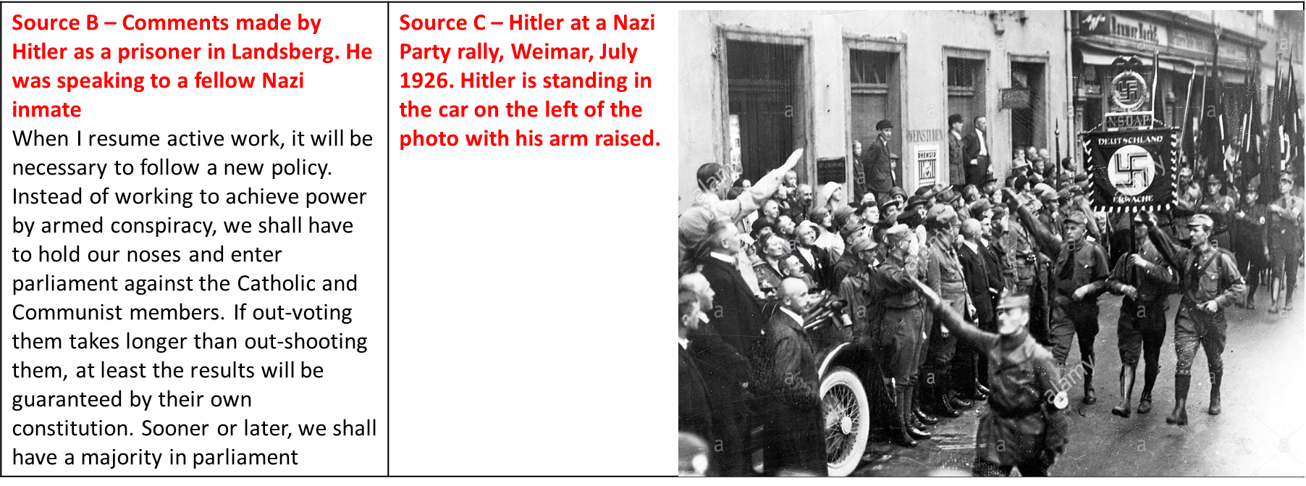
Tasks:
1.Read the Source B paragraph
2. Using 3 different highlights, identify the following:
Where I identify what the source says about the Q
Where I use my own knowledge to explain why this is useful
Where I explain how the PROVENANCE effects its usefulness
Q3 (a) – How useful are sources B and C for an enquiry into the development of the Nazi Party, 1924-29? Explain your answer, using sources B and C and your own knowledge of historical context.(8 marks)
Source B is useful for an enquiry into the development of the Nazi Party 1924-29 because it talks about how the Nazi’s changed tactics from trying to get power through ‘armed conspiracy’ to using ‘parliament’ to gain power. This is useful as this did happen. After the failure of the Munich Putsch in 1923 which was an armed rebellion by the Nazis the party realised that they couldn’t take power through force. Instead they started to try and increase the number of people voting for them so they had could have more presence in the Reichstag. Hitler also ran for President in 1932 which supports this change of tactic. The provenance makes it useful as it from a Nazi inmate which means they will have knowledge of party tactics and policies. He also has no reason to lie as it is part of a conversation with a fellow Nazi so it can be assumed he will be speaking honestly and openly.
Source C is useful for learning about the development of the Nazi Party because it shows..
This is useful because I know that…
The provenance makes it useful because…

Slide 11
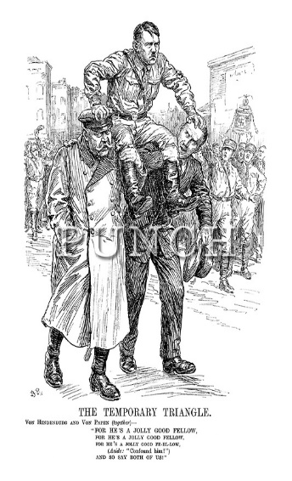
Source C: From Berlin Stories, by Christopher Isherwood, published in 1945. Isherwood was a British Journalist living in Berlin at the time Hitler came into power in Germany.
Each week there were new emergency decrees. Bruning’s weary l voice issued commands … and was not obeyed … Berlin was in a state of civil war. Hate exploded … out of nowhere; at street corners, in restaurants, cinemas … at midnight … in the middle of the afternoon. “Bruning is weak” they said. “What these swine need is a man with hair on his chest.” … People said that the Nazis would be in power by Christmas.
Source B: A 1933 cartoon from the British political magazine Punch. It shows Hindenburg (on the left) and von Papen (on the right) lifting Hitler to power.
Tasks:
1.Read the Source B paragraph
2. Using 3 different highlights, identify the following:
Where I identify what the source says about the Q
Where I use my own knowledge to explain why this is useful
Where I explain how the PROVENANCE effects its usefulness
Q3 (a) – How useful are sources B and C for an enquiry into the way Hitler came to power? Explain your answer using sources B and C and your own knowledge of the historical context. (8 marks)
Source B is useful for an enquiry into the way Hitler came to power because it is a cartoon showing that Hitler was helped into a position of power by Hindenburg and Von Papen. That is why they are lifting him up in the cartoon. This is useful as my own knowledge agrees these men did help Hitler come to power. Hindenburg was the President who in January 1933 asked Hitler to become chancellor. He did this after Von Papen (a politician he preferred) failed to keep control as Chancellor. Von Papen also helped Hitler come to power because he made a deal with him that he would be Vice Chancellor if Hitler was picked as Chancellor. This made Hitler more appealing to Hindenburg as he thought Von Papen could control him a little bit. This is why Hindenburg eventually picked Hitler to be chancellor. The provenance of the source makes it limited as it is a cartoon and it is therefore meant to be entertaining rather than a truthful reflection of events. It leaves out key details because it is a cartoon and therefore cannot show everything and has to be simplistic. It is a British cartoon which could make it more useful as they are not directly involved in the events but they might not know the full details of what was going on behind closed German doors.
Source C is useful for learning about the way Hitler came to power because it shows..
This is useful because I know that…
The provenance makes it useful because…

Slide 13
Source B: From Hitler’s speech to the Reichstag on 13 July 1934, justifying his actions in the Night of the Long Knives concerning the SA. In the circumstances I had to make but one decision. If disaster was to be prevented at all, action had to be taken with lightening speed. Only a ruthless and bloody intervention might still perhaps stifle the spread of revolt. If anyone reproaches me and asks why I did not resort to the regular courts of justice for conviction of the offenders, then all I can say is, ‘In this hour I was responsible for the fate of the German people and therefore I became the supreme judge of the German people.’ | Source C: From a report of the Reich cabinet meeting about the Night of the Long Knives, printed in the Volkischer Beobachter (the official Nazi newspaper), 5 July 1934. Defence Minister General von Blomberg thanked the Fuhrer in the name of the Reich Cabinet and the army for his determined and courageous action, by which he saved the German people from a civil war. The Fuhrer had shown greatness as a statesman and a soldier. This had aroused in the hearts of the German people a vow of service, devotion and loyalty in this grave hour.
Tasks:
1.Read the Source B paragraph
2. Using 3 different highlights, identify the following:
Where I identify what the source says about the Q
Where I use my own knowledge to explain why this is useful
Where I explain how the PROVENANCE effects its usefulness
Q3 (a) – How useful are sources B and C for an enquiry into Night of the Long Knives? Explain your answer, using Sources B and C, and your own knowledge of the historical context. (8 marks)
Source B is useful for an enquiry the Night of the Long Knives because it suggests that Hitler carried out the Night of the Long Knives because he felt threatened by the SA and feared the ‘spread of revolt’. This is useful because it matches my own knowledge. I know Hitler was concerned that Rohm the leader of the SA wanted to take over the Germany army. He was also worried about the fact the SA members owed their allegiance to Rohm rather than him and therefore that they could be used by Rohm in a revolt against him. This is why Hitler ordered the Night of the Long Knives which is when Rohm and other leading members of the SA were shot so that any potential threat of the SA would be removed. The provenance makes it useful in that it is from Hitler so it gives us insight into his reasons for carrying out the Night of the Long Knives. However, the fact it is from a speech given to the Reichstag limits it as the purpose of this would have been to justify his illegal actions and make him seem like he did the right thing, this means he might not have been honest about what he was saying.
Source C is useful for learning about the Night of the Long Knives because it shows..
This is useful because I know that…
The provenance makes it useful because…

Slide 15
Source B: From the memoirs of Rudolf Diels, Head of the police in 1933. He was writing about Hitler’s reaction to the Reichstag fire. Diels arrived at the Reichstag soon after it had been set on fire on 27 February 1933. He wrote his memoirs in 1950. Shortly after my arrival at the burning Reichstag, Hitler arrived. Hitler was standing on a balcony gazing at the red ocean of fire. His voice was heavy with emotion: ‘This is the beginning of the Communist revolt, they will start their attack now! Not a moment must be lost.’ He shouted uncontrollably, as I had never seen him do before, as if he was going to burst: ‘There will be no mercy now. Anyone who stands in our way will be cut down. Every communist official will be shot when he is found. Everyone in league with the Communists must be arrested. There will also no longer be leniency for Social Democrats.’ | Source C: Marinus van der Lubbe, statement to police (28th February, 1933). He was a young communist arrested for setting the Reichstag on Fire but also know to be mentally unstable. The first fire went out. Then I lit my shirt on fire and carried it farther. I went through five rooms.... I do nothing for other people, all for myself. No one was for setting the fire. The workers should rebel against the state order. The workers should think that it is a symbol for a common uprising against the state order.
Tasks:
1.Read the Source B paragraph
2. Using 3 different highlights, identify the following:
Where I identify what the source says about the Q
Where I use my own knowledge to explain why this is useful
Where I explain how the PROVENANCE effects its usefulness
Q3 (a) – How useful are sources B and C for an enquiry into the Reichstag Fire? Explain your answer, using Sources B and C, and your own knowledge of the historical context. (8 marks)
Source C is useful for an enquiry the Night of the Long Knives because it shows that Marinus Van Der Lubbe was guilty of setting the Reichstag on Fire. This is useful as it matches my own knowledge. I know he was found at the scene of the crime with materials used to start the Fire. He was arrested and later executed for this crime. It suggests that he did it as an act of rebellion against ‘the state order’. This is useful as this is what the public were told about why he lit the fire. They were told this was an attempt by the communists to undermine the government of Germany. The provenance makes it useful as it is a first hand confession which suggests it reflects the truth. It was given to the police so it seems unlikely he would lie about this. However, the provenance also says he was known to be mentally unstable so this raises questions about whether he is telling the truth or whether he may have been bullied into making this statements.
Source B is useful for learning about the Reichstag fire because it shows…
This is useful because I know that…
The provenance makes it useful because…

Slide 17
Source B: From a speech by David Lloyd George, an ex-prime minister of Britain, speaking to the British press in 1937.
Whatever one may think about Hitler’s methods there can be little doubt that he has achieved a marvellous transformation in the spirit of their people … and in their social and economic outlook. As to his popularity, especially amongst the youth of Germany, there can be no manner of doubt. The old trust him; the young idolise him. It is not the admiration accorded to a popular leader. It is the worship of a national hero who has saved his country from utter despondency and degradation.
Source C: An incident reported in the Rhineland, July 1938.
In a café, a 64 year old woman remarked to her companion at the table: ‘Mussolini [leader of Italy] has more political sense in one of his boots than Hitler has in his brain.’ The remark was overheard and five minutes later the woman was arrested by the Gestapo, who had been alerted by telephone.
Tasks:
1.Read the Source B paragraph
2. Using 3 different highlights, identify the following:
Where I identify what the source says about the Q
Where I use my own knowledge to explain why this is useful
Where I explain how the PROVENANCE effects its usefulness
Q3 (a) – How useful are sources B and C into the success of Nazi control in the years 1933-39? Explain your answer, using Sources B and C, and your own knowledge of the historical context. (8 marks)
Source B is useful for an enquiry into the success of Nazi control 1933-39 because it suggests they gained control by improving the ‘social and economic outlook’ to increase his popularity. This is useful as it is true. The Nazis did introduced policies like the RAD and conscription which improved unemployment and so the Nazi’s did gain popularity. The source also says he was sucessful at controlling the youth because it says they ‘idolised’ him. This is also useful because it is true. The Nazis used education and the Hitler Youh to indoctrinate young people and to make them committed Nazis. The provenance of the source makes it useful because it is said by the British prime minister who has no reason to lie or exaggerated about positives in Germany, especially in 1937 when Britain was preparing for war with Germany.
Source B is useful for learning about the Reichstag fire because it shows…
This is useful because I know that…
The provenance makes it useful because…

Slide 19
Source B: From a British magazine, 2938
There seems little enthusiasm for the Hitler Youth, with membership falling. Many no longer want to be commanded, but wish to do as they like. Usually only a third of the group appears for role-call. At evening meetings it is a great evening if 20 turn up out of 80, but usually there are only about 10 or 12.
Source C: Hitler youth member, private letter, 1936
How did we live in Camp S---, which is supposed to be an example to al the camps? We practically didn’t have a minute of the day to ourselves. This isn’t camp life, no sir! It’s military barrack life! Drill starts right after a meagre breakfast. We would like to have athletics but there isn’t any. Instead we have military exercises, down in the mud, till the tongue hangs out of your mouth. And we have only one wish: sleep, sleep …
Q3 (a) – How useful are sources B and C for an enquiry into the Hitler Youth? Explain your answer, using sources B and C and your knowledge of the historical context. (8 marks)
Source A is useful for learning about the Hitler Youth because it shows…
This is useful because I know that…
The provenance makes it useful because…
Source B is useful for learning about the Hitler Youh because it shows…
This is useful because I know that…
The provenance makes it useful because…

Slide 21
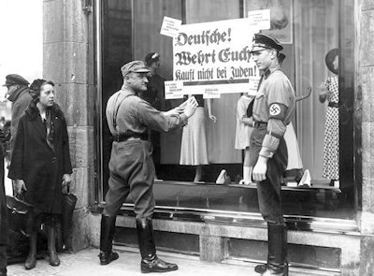
Source C: The Reich Citizenship Law, 1935.
Only a national of Germany or similar blood, who proves by his behaviour that he is willing and able loyalty to serve the German people and Reich is a citizen of the Reich. A Jew may not be a citizen of the Reich. He has no vote. He may not hold any public office.
Source B: Photograph showing the SA-enforced boycott of Jewish shops in April 1933.
Q3 (a) - How useful are sources B and C for an enquiry into the treatment of Jews in Nazi Germany? Explain your answer, using sources B and C and your knowledge of the historical context. (8 marks)
Source A is useful for learning about the treatment of Jews in Nazi Germany because it shows
This is useful because I know that…
The provenance makes it useful because…
Source B is useful for learning about the treatment of Jews in Nazi Germany because it shows…
This is useful because I know that…
The provenance makes it useful because…

