Slide 1
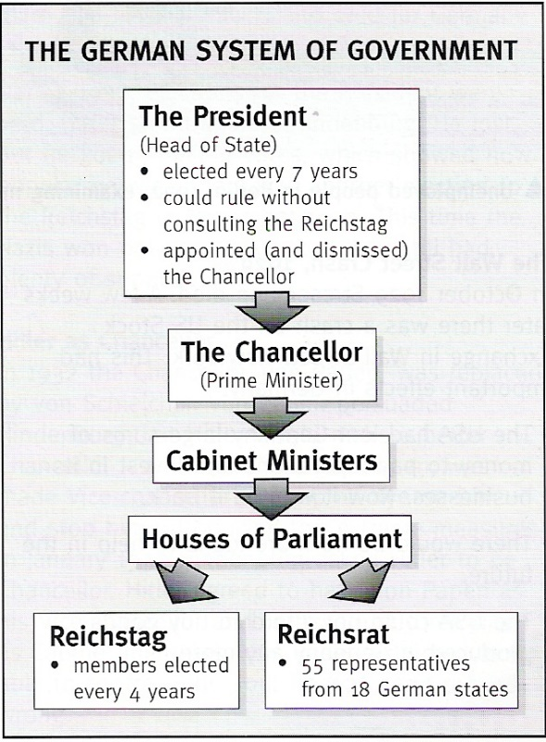
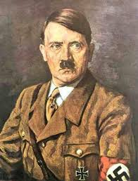
Paper 1 Germany c. 1919 - 1945
1919 – 1933 Weimar Germany
Germany is a Democracy
People can vote
People have rights
1933 – 1945 Nazi Germany
Germany is now a Dictatorship
Hitler in total control
People have no say
Hitler becomes Chancellor in 1933. He quickly makes Germany a Dictatorship.

Slide 2
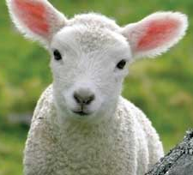




November 1918- Germany asks for a ceasefire (end to fighting) They are exhausted, bankrupt and cannot carry on. They get no say in the decisions that are made next……… The Treaty of Versailles. Remember LAMB
Land
13% of Germany given away to France, Belgium, Poland
All land overseas (colonies) taken
No German troops allowed in Rhineland (to make France feel safe)
Army
Only 100,000 soldiers allowed
No planes, tanks or submarines
Only 15,000 sailors
Most of navy sunk - only allowed 6 battleships
Money
Germany is told it must pay for the war (called reparations)
In 1921 it was decided they should £6.6 billion!
Blame
Germany had to sign to say all the deaths and destruction was their fault
This meant the winners (allies) could claim compensation from Germany (see box on left – Money)
Bad years for the Weimar Government
Who decided all this? The winners Clemenceau, Wilson Lloyd George in June 1919

Slide 3
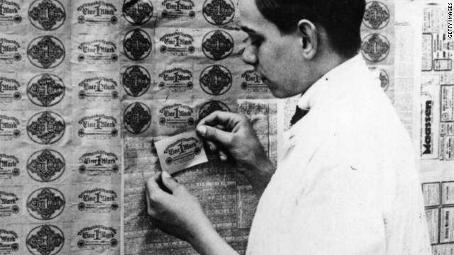
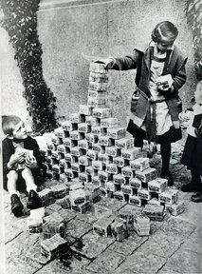
Problems for the new Weimar Government right from the Start!
Political Groups attacking them
Spartacists in 1919 – they wanted a communist revolution like in Russia. Wanted to overthrow government. Failed.
Freikorps – a groups of ex soldiers who hated the government, led by Wolfgang Kapp they tried to take control of Berlin. Failed.
The Nazis – in 1923 tried to seize power in the Munich (or Beer Hall) Putsch. Failed. Hitler put in prison.
Trouble with the French!
In 1922 Germany said they could not pay their reparations.
The French were not happy and invaded an area called the Ruhr in Germany to take coal, factory goods etc as payment.
The German government told the workers to strike so the French could not take what they produced.
Hyperinflation > Causes
Hyperinflation is when money loses value and you need billions of marks to buy just an egg or a cup of coffee
Caused by
Bankruptcy + Reparations bill + paying striking workers in Ruhr = Hyperinflation (1923 was worst year) In 1923 a stamp cost 22 million marks!
Hyperinflation > Results
People’s savings wiped out
Hunger, homelessness, unemployment
Crime – people stole, riots
People used the money to light fires, let children play with it as it had no value
BUT for people in debt it was good – they could pay their debt back easily
Bad years for the Weimar Government

Slide 4
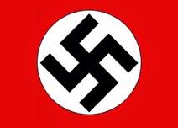
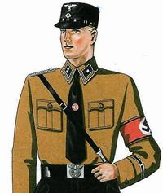
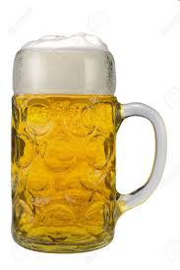
Problems for the new Weimar Government right from the Start!
The New Nazi Party – set up in 1920 (also known as the NSDAP)
Hitler sets up Nazi Party in 1920. Makes himself leader
Creates the swastika flag
Sets up the SA (Nazi Party private army)
Good Speaker
What did the Nazis believe in?
Nationalism (Germany the greatest)
Dictatorship (hated democracy)
Racial Purity German blood (Aryans) better than all others and must be kept pure
No place for the weak or ill
No non Germans should be allowed in Germany
Hated Communism! Their greatest enemy
Nazi First Attempt to take Power
The Munich or Beer Hall Putsch 1923
Hitler and 600 SA members burst into a beer hall where leaders of Munich (Germany’s 2nd biggest city) are having a meeting – force them to join them.
Next day they march but authorities have been tipped off, army stops them and Hitler arrested and 16 Nazis killed
Was the Munich or Beer Hall a Total Disaster for the Nazis?
Yes
It failed
Hitler arrested
Put in prison
But…..
Got lots of publicity
Learnt he would have to get elected rather than take power by force……..a valuable lesson
Bad years for the Weimar Government

Slide 5
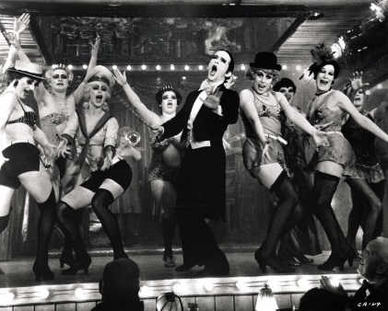
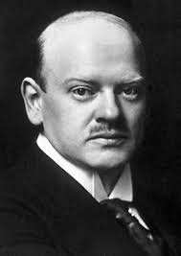

1924 – 1929 Better years for the Government – the Work of Stresemann (Germany’s Chancellor)
Improving Germany’s money problems (the economy)
Started a new currency, got rid of hyperinflation
Got reparations down to a more manageable amount >
Dawes Plan – gave Germany longer to pay
Young Plan reduced amount down from £6.6 to £2.2 billion
Borrowed a lot of money from USA to get Germany’s economy going again
Improving Relations with Other Nations
Promised to accept the land borders agreed at Versailles
Started paying reparations again to France
Promised not to use war to get what he wants
Stresemann awarded Nobel Peace Prize (shows other countries trust him)
Germany becomes Trendy
Also during this time Berlin in particular becomes the place to be – lots of nightlife, clubs, music, theatre, art etc
Lots of tourists – brings in more money
BUT
A lot of the improvements had needs help and money from USA. (USA had loaned Germany millions of dollars.)
If anything happened to USA’s economy then it would drag Germany down with it……….
(Hint: Think about Wall St Crash in 1929)
Better years for the Weimar Government
(Nobody listening to the Nazis during these good years)

Slide 6
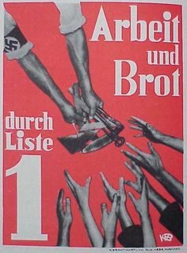
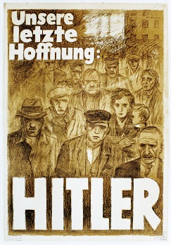
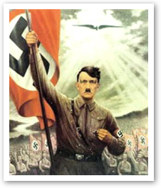

1929 - 1933 Bad years for the Government again!– Nazis gaining popularity….
Wall St Crash 1929 – America’s economy in trouble
USA wants its money back from Germany – this means Germany in trouble financially again
Stresemann dies in 1929 – another blow for Germany
Weimar government don’t seem to be able to sort things out – lots of arguing – German people not impressed
Rich people worried about Communism
6 million unemployed by 1932
What were the Nazis Doing? Why did people start listening and voting for them?
Promises for everyone – unemployed, big businesses, farmers etc
Posters
Speeches
Rallies and broadcasts
They look organised and appealing at a time of chaos
RIP
By 1932 the Nazis are the largest political party in Germany
Reluctantly the President makes Hitler Chancellor
Believes they (Hindenburg and von Papen) will be able to control Hitler – BIG MISTAKE!
Hitler made Chancellor in Jan 1933
So, by Jan 1933, Hitler is Chancellor (Prime Minister) Germany is not yet a dictatorship but it soon will be…….
Bad years for the Weimar Government
Good years for the Nazis
‘Work and Bread’ Nazi poster
‘Our last Hope - Hitler’ Nazi poster
‘Hitler the Saviour’ Nazi poster

Slide 7
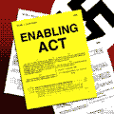
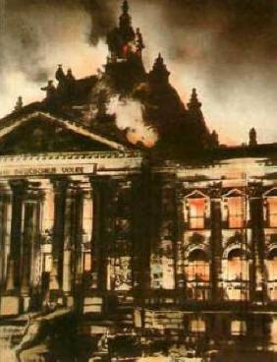
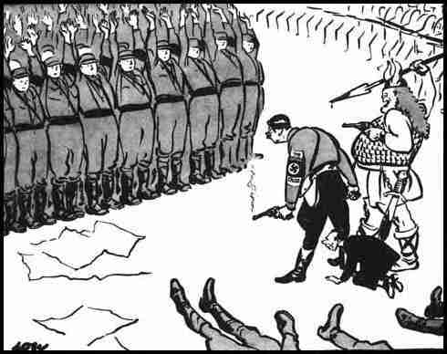
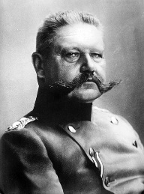
1933 – 1945 Nazis in Power Germany is a Dictatorship – How did this happen?
Step 1 Feb 1933 – Reichstag Fire
Reichstag burned down by a communist (so the Nazis claim)
Hitler given emergency powers to arrest people without trial, close down Communist party meetings etc as he convinces people it is a Communist plot to take over Germany.
This fire is a gift to the Nazis (did they set it up??)
Step 2 Mar 1933 The Enabling Act
Hitler gets the Reichstag to pass a law saying Hitler can pass any law he likes without having to consult (ask) anyone. This is really important and basically makes him a dictator.
He can do this as he has banned the Communists and ‘persuades’ most of the other parties to vote with him. 82% do so.
Immediately Hitler bans all other political parties.
Step 3 - June 1934 The Night of the Long Knives
For a while Hitler has been worried by the size of the SA and how they are loyal to their leader (Rohm) rather than Hitler himself.
He decided to accuse them of plotting against him. 400 of them are killed.
Hitler acting illegally to make sure he cannot be threatened
Step 4 – Death of President Hindenberg
The last person in Hitler’s way dies. Hitler combines the job of President and Chancellor and calls himself Fuhrer (Supreme Leader)
RIP

Slide 8
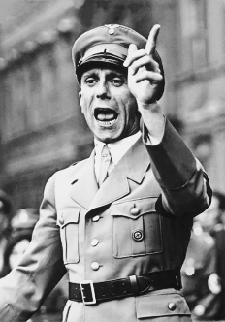
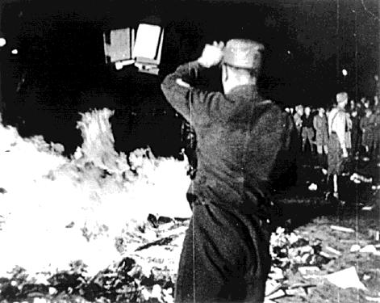
How did Hitler Control Germany and stop people speaking out? Part 1
First he made sure people only knew what he wanted them to know - the Nazi view (Getting them to think what you want is called propaganda, controlling what they can know is called censorship.)
The man in charge of this was Josef Goebbels who was Minister for Propaganda
Methods Used to keep German People supporting the Nazis and not questioning them
Books – were banned or burnt if the Nazis did not approve of them
Newspapers – had to report the news the way the Nazis wanted it or they were shut down.
Radio - all radio broadcasting controlled by Nazis. No foreign radio stations allowed. Listening to them punishable by death. Radio speakers set up everywhere so people had to listen to Hitler’s speeches etc.
Films – had to be approved by Goebbels, often had Jewish characters as the villain
Art – paintings promoted the Aryan look (blond blue eyed)
Sport - Berlin Olympics in 1936 - carefully planned to show off the achievements of the Nazis and promote their master race ideas. BUT black American athlete Jesse Owens won four gold medals.

Slide 9
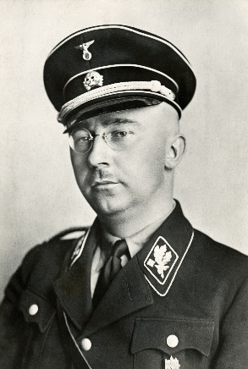
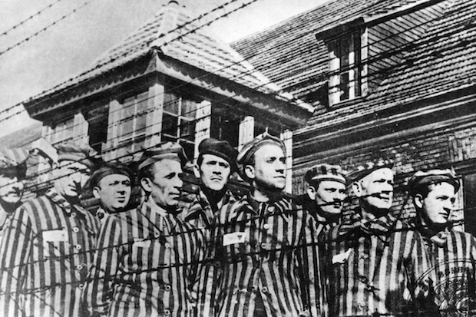
How did Hitler Control Germany and stop people speaking out? Part 2
For those not convinced by the propaganda and censorship there was fear and terror to keep them quiet.
The man in charge of this was Heinrich Himmler who was Leader of the SS (originally they were Hitler’s bodyguard – ended up running the camps)
Methods Used to keep German People silent through fear
Concentration Camps – set up for anyone one who criticised the Nazis or anyone the Nazis disapproved of. Brutal prison camps with torture and hard labour.
Gestapo –the secret police, they tapped phone lines, opened mail, listened in on conversations. Much feared.
SS - the main group responsible for terror in Nazi Germany. They ran the concentration and later the death camps. Had to be Aryan. Were 240, 000 of them
SD – Set up in 1931 as the intelligence body of Nazi party to look for actual and potential enemies (bit like MI5)
Police and Law Courts. All put under the control of Himmler. Nazi judges appointed. 46 crimes carried the death sentence.
Local Wardens – designed to check up on everyone and report anyone not seen to be a loyal Nazi

Slide 10
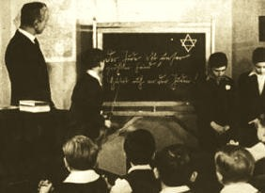
How did Hitler try to get Young People’s Support and Loyalty?
Hitler believed if he got the young on his side the Nazi future would be secure. He worked hard to ensure children were taught to be loyal Nazis.
Young people’s lives changed dramatically both in school and out of school.
Methods Used to train German children to be good Nazis
New textbooks – taught History the way the Nazis wanted it taught. Jews blamed for past German disasters (Like losing WW1).
New subjects – like Race Studies taught children some races better than others and that the Jews were the lowest of all.
Teachers had to join Nazi League of Teachers and teach Nazi views.
PE – the amount of PE increased dramatically to make everyone fit and strong either for the army (boys) or for childbirth (girls).
Maths – even maths questions got children to calculate how much money Germany would save if it got rid of all its disabled people.
Out of school – children had to join the Hitler Youth groups.
German children being taught to see ‘the Jew’ as their enemy

Slide 11
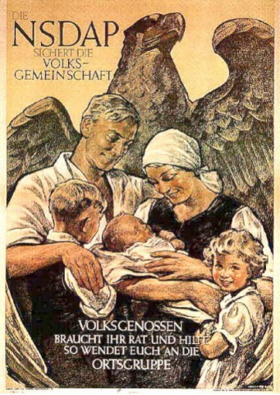
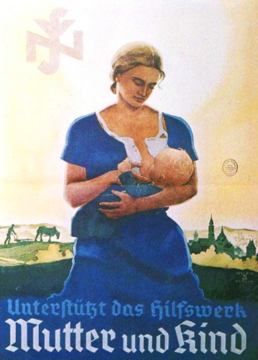
How did life for Women Change under the Nazis?
Hitler was worried about Germany’s falling birth rate. He wanted the population to increase to build a strong Germany so he wanted women to be mothers. Nazi posters showed women in the role Hitler wanted them to have.
Methods Used to Get Women to be Mothers
A Marriage loan – if you married you got a large loan and you could keep 25% of it for each child you had (4 children = nothing to pay back)
Medals for having children – bronze (4), silver (6) and gold (8)
Women sacked from government jobs.
Traditional clothes and hair encouraged .
Women taught that their life should be about Children, Church and Cooking – (Kinder, Kirche, Kuche)
BUT, once the second world war broke out in 1939, Germany needed more workers so it tried to persuade women back to the factories etc, this wasn’t very successful.
Women who had conditions or illnesses that could be passed on to their children were sterilised (not allowed to have children) Hitler did not want any ‘imperfections’ in his Master Race.

Slide 12
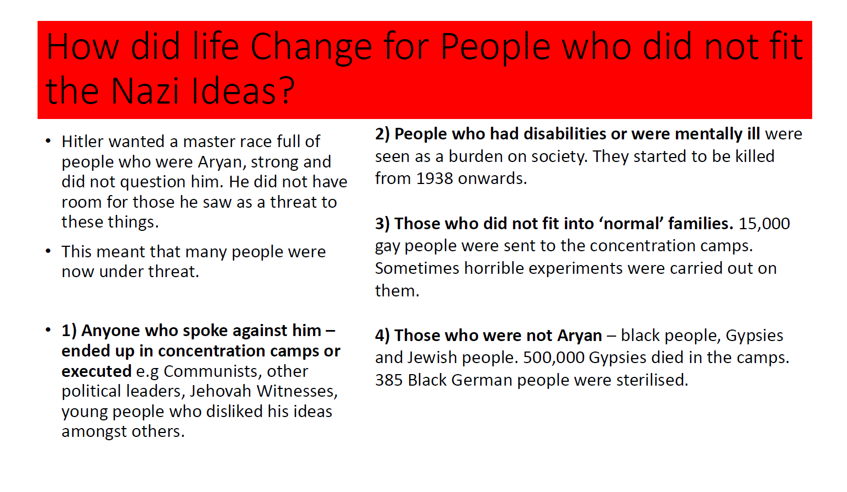

Slide 13
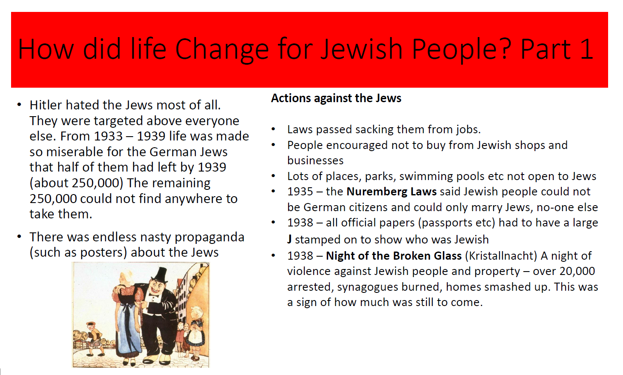

Slide 14
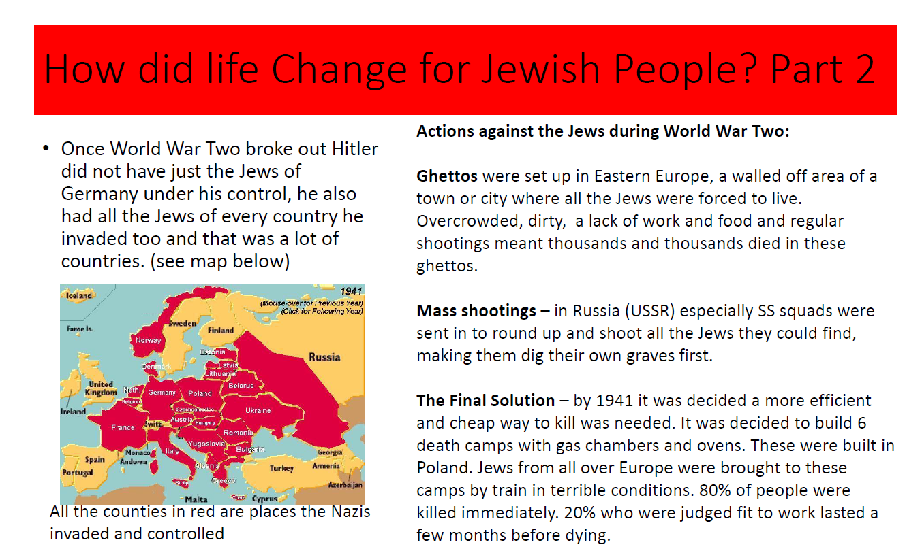

Slide 15
