Slide 1
Section B of the Exam
Section B will all be one one topic e.g. The Hitler Youth OR Why did people vote for the Nazi.
You will get 4 questions on this topic. The questions are designed to access your historical skills (A03 = source analysis, A04 = use of interpretations)
QUESTION STYLE | AOs | Marks
How useful would sources B and C be for an enquiry into….. | AO3 | 8
What is the main difference between the interpretations | AO4 | 4
Explain one reason for a different between the interpretations | AO4 | 4
How far do you agree with interpretation X.. | AO4 | 16 + 4 SPaG

Slide 2
3a) How useful are sources B and C for an enquiry into the extent of Weimar recovery between the year 1924 - 1929?
Source B: From a German journalist written in 1930 In comparison with what we expected after Versailles, Germany has raised herself up to shoulder the terrific burden of this peace in a way we would never have thought possible. So that today after 10 years we say with certainty ‘Even, so it might have been worse. The journey of recovery from Versailles is a very long road to go and we have travelled it surprisingly quickly
Source C: From a speech by Stresemann, 1929 The economic position is only flourishing on the surface. Germany is in fact dancing on a volcano. If the short terms loans are called in by America, a large section of our economy would collapse.

Slide 3
3a) How useful are sources B and C for an enquiry into the extent of Weimar recovery between the year 1924 - 1929?
Source B: From a German journalist written in 1930 In comparison with what we expected after Versailles, Germany has raised herself up to shoulder the terrific burden of this peace in a way we would never have thought possible. So that today after 10 years we say with certainty ‘Even, so it might have been worse. The journey of recovery from Versailles is a very long road to go and we have travelled it surprisingly quickly
Source B says……………………………………………………………………………………………………………………………………………………
This is useful because …………………………………………………………………………………………………………………………………...
This is accurate because ……………………………………………………………………………………………………………………………….
……………………………………………………………………………………………………………………………………………………………………………….
The ……………………………………….. of source B is ………………………………………………………………………………………………
This is useful/not useful for the enquiry because ………………………………………………………………………………….
………………………………………………………………………………………………………………………………………………………………………………
Overall the source is …………………………………… useful.

Slide 4
3a) How useful are sources B and C for an enquiry into the extent of Weimar recovery between the year 1924 - 1929?
Source C: From a speech by Stresemann, 1929 The economic position is only flourishing on the surface. Germany is in fact dancing on a volcano. If the short terms loans are called in by America, a large section of our economy would collapse.
Source C says……………………………………………………………………………………………………………………………………………………
This is useful because …………………………………………………………………………………………………………………………………...
This is accurate because ……………………………………………………………………………………………………………………………….
……………………………………………………………………………………………………………………………………………………………………………….
The ……………………………………….. of source C is ………………………………………………………………………………………………
This is useful/not useful for the enquiry because ………………………………………………………………………………….
………………………………………………………………………………………………………………………………………………………………………………
Overall the source is …………………………………… useful.

Slide 5
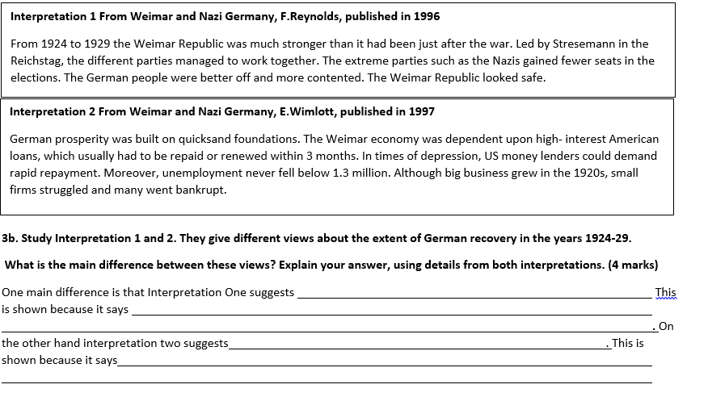
3b) Study Interpretations 1 and 2. They give different views about the extent of Weimar recovery between the year 1924 - 1929. What is the main difference between the views? Explain your answer, using details from both interpretations.

Slide 6
3c) Suggest one reason why Interpretations 1 and 2 give different views about the extent of Weimar recovery between the year 1924 - 1929.
Why do historians differ in their views on the same topic?
They have used different historical sources
They are partial extracts
They have different focuses

Slide 7
3c) Suggest one reason why Interpretations 1 and 2 give different views about the extent of Weimar recovery between the year 1924 - 1929.
One reason why the interpretation different is that they have use different historical material. Interpretation one which
gives a …………………………. view, shown by the quote…………………………………………………………………….………………………………………………………………
May have used sources such as source ……… which suggests………………………………………………………………………………………………………………
Shown by the quote ……………………………………………………………………………………………. Whereas interpretation two gives a ………………………….
view, shown by the quote…………………………………………………………………………………………………………………...…May have used sources such as
source ……… which suggests……………………………………………………………………………………………………………………………………………………..,
Shown by the quote ……………………………………………………………………………………………

Slide 8
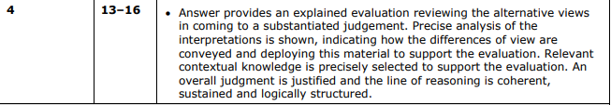
How far do you agree with Interpretation 2 about the extent of Weimar recovery between the year 1924 - 1929 Explain your answer, using both interpretations and your knowledge of the historical context.
What must I do?

Slide 9
How far do you agree with Interpretation 2 about the extent of Weimar recovery between the year 1924 - 1929 Explain your answer, using both interpretations and your knowledge of the historical context.
Interpretation two says…………………………………………………………………………………………………………………………………
This suggests………………………………………………………………………………………………......................................................
I agree with this interpretation to a …………………………. extent because [contextual knowledge]
……………………………………………………………………………………………………………………………………………………………………………
……………………………………………………………………………………………………………………………………………………………………………
x2

Slide 10
How far do you agree with Interpretation 2 about the extent of Weimar recovery between the year 1924 - 1929 Explain your answer, using both interpretations and your knowledge of the historical context.
Interpretation one says…………………………………………………………………………………………………………………………………
This suggests………………………………………………………………………………………………......................................................
I agree with this interpretation to a …………………………. extent because [contextual knowledge]
……………………………………………………………………………………………………………………………………………………………………………
……………………………………………………………………………………………………………………………………………………………………………
x2

Slide 11
The two interpretation convey their differences in the way they are written. For example
interpretation one gives a ……………………………. Perspective which is show through the authors
choice of words, such as …………………………………… and ……………………………. On the other hand
interpretation one gives a ………………………………. Perspective which is conveyed through the use of
words such as such as …………………………………… and …………………………….
Overall I agree with interpretation two to a ………………………….. Extent. This is because ………………….
……………………………………………………………………………………………………………………………………………………………………………….
……………………………………………………………………………………………………………………………………………………………………………….
It is more/less accurate than interpretation one because …………………………………………………………………..
……………………………………………………………………………………………………………………………………………………………………………….
……………………………………………………………………………………………………………………………………………………………………………..

